Slide 1
PACE Codes C and H – Menstrual Care and Dignity in Custody
Bitesize training for ICVs

Slide 2
Objectives
To give context to changes in PACE Code C and H.
To look in detail at the changes made to PACE Code C and H in terms of menstrual care for detainees.
To examine the inclusion of dignity in PACE Code C and H.
To ensure ICVs are confident of what to monitor as per the changes to PACE Code C and H.

Slide 3
What is PACE Code C?
What are the PACE Codes of Practice?
PACE (Police and Criminal Evidence Act sets out to strike the balance between the powers of the police and the rights and freedoms of the public.
What is PACE Code C?
PACE Code C details the requirements of the police for the detention, treatment and questioning of suspects not related to terrorism in police custody. This is, therefore, the relevant Code to custody visiting.
Notes:
Note: There is a briefing paper for ICVs on the members site, covering both PACE and the APP with more detail as to what they are and what they cover, you may wish to give this as a background handout or as a pre-read to this session. The following is also worth noting at this point:
What is PACE Code H?
PACE Code H is the revised code of practice for the police in connection with detention, treatment and questioning by police officers under the Terrorism Act 2000. This Code will cover arrangements for those areas who have TACT visitors, either as the area has a designated TACT suite, or the capability to hold Terrorism detainees in designated cells. The arrangements, headings and content of PACE Code H are similar to that in Code C. All of the changes detailed in the following slides also apply to PACE Code H as well as PACE Code C.

Slide 4
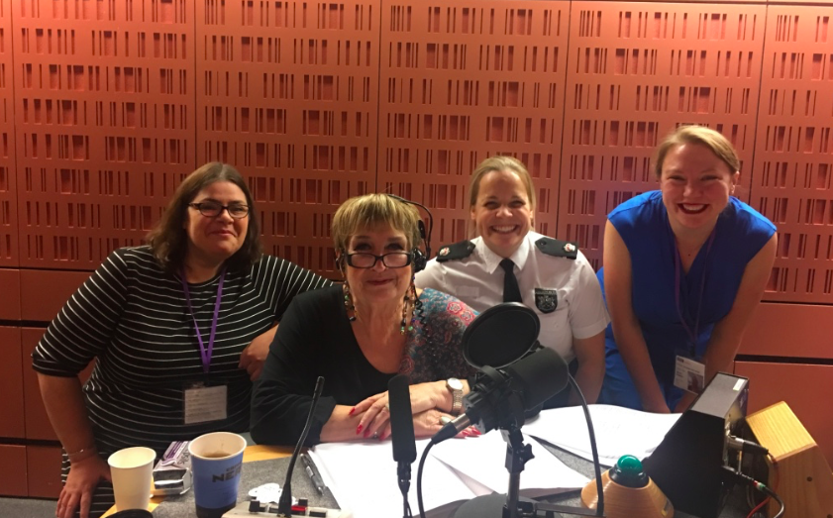
Why has PACE Code C been updated?
ICVs reported 2 cases of women being left without menstrual products, without their own clothes due to perceived risk of self harm.
ICVA researched and surveyed all forces with assistance and support from the National Police Chiefs Council to establish supplies and arrangements for menstruating women.
ICVA was offered pro-bono legal support to challenge the Home Office on inconsistent and poor arrangements for menstruating women and girls.
The campaign was launched, and the then Home Secretary responded quickly stating that where effective provision was not put on a statutory footing she would ensure that it was.
The Home Office worked with ICVA and other stakeholders to draft changes to the legislation, publicly consulted and announced the changes formally.
Notes:
This is a very very brief overview of the campaign, More detail on the campaign and the engagement can be found in the media centre of our website including press releases etc on the changes. Also further blogs can be found on the custody visiting wordpress site.

Slide 5
List of concerns
As part of the call for change, ICVA compiled a list of concerns in this area, including but not limited to:
Women and girls being proactively asked about their needs in terms of menstrual protection.
Women having access to a female member of staff, (this is already in the legislation for girls in custody).
Adequate hand washing facilities should be in place.
Female detainees should be made aware that toilet areas are pixelated.
Should a strip-search be required, sensitivity should be shown.
Risk should be carefully considered, and removal of menstrual protection should be carefully risk assessed, with consideration given to higher levels of observation prior to the removal of any menstrual protection.
Notes:
Please note and let ICVs know that documents including the full list of asks are available on the icva website – this also includes the detailed legal opinion, offered pro-bono from Doughty St.

Slide 6
Changes to PACE – Menstrual Care - 1
3.2
This is the section of PACE that details that rights and entitlements leaflets should be given to all detainees – this section has been updated to include the following in the entitlements section:
personal needs relating to health, hygiene and welfare concerning the provision of menstrual and any other health, hygiene and welfare products needed by the detainee in question and speaking about these in private to a member of the custody staff (see paragraphs 9.3A and 9.3B).
Notes:
This means that all women and girls will know that they are entitled to menstrual products and that they are able to speak about this in private. Custody staff must give offer this leaflet to all detainees in an accessible format in terms of language/easy read etc.

Slide 7
Changes to PACE - Menstrual Care - 2
3.5
This section deals with the booking in process and has been updated to state:
(iia) wishes to speak in private with a member of the custody staff who may be of the same sex about any matter concerning their personal needs relating to health, hygiene and welfare (see paragraph 9.3A);
Notes:
This section means that all detainees must be able to speak to a member of the same sex as themselves if they wish to do so. Discuss why this is important. This is a big step forward to state that women must be able to speak to female staff if they wish to do so. PACE has always had this for girls, but it is now for all all female detainees. NOTE: PACE goes on to state that any decision on this matter must be recorded in the custody record of the detainee.

Slide 8
Changes to PACE - Menstrual Care - 3
3.20A
This section has been updated to include:
The Children and Young Persons Act 1933, section 31, requires that arrangements must be made for ensuring that a girl under the age of 18, while detained in a police station, is under the care of a woman. The custody officer must ensure that the woman under whose care the girl is, makes the enquiries and provides the information concerning personal needs relating to their health, hygiene and welfare described in paragraph 9.3A and menstrual products described in paragraph 9.3B
Notes:
This provides the updated text for girls in custody. NOTE: Detail on 9.3A and 9.3B are in a subsequent slide.

Slide 9
Changes to PACE - Menstrual Care - 4
4.3A
This is the section concerned with detainees property and has been updated to include:
For the purposes of paragraph 4.2, the reference to clothing and personal effects shall be treated as including menstrual and any other health, hygiene and welfare products needed by the detainee in question (see paragraphs 9.3A and 9.3B) and a decision to withhold any such products must be subject to a further specific risk assessment.
Notes:
This means that subject to risk assessment, should a woman or girl in custody wish to use her own menstrual protection which she has with her at the time of arrest, she should be able to do so.

Slide 10
Changes to PACE - Menstrual Care - 6
9.3A
This is the note earlier referred to in PACE.
As soon as practicable after arrival at the police station, each detainee must be given an opportunity to speak in private with a member of the custody staff who if they wish, may be of the same sex as the detainee (see paragraph 1.13(c)), about any matter concerning the detainee’s personal needs relating to their health, hygiene and welfare that might affect or concern them whilst in custody. If the detainee wishes to take this opportunity, the necessary arrangements shall be made as soon as practicable. In the case of a juvenile or vulnerable person, the appropriate adult must be involved in accordance with paragraph 3.17 and in the case of a girl under 18, see paragraph 3.20A. (See Note 9CB).

Slide 11
Changes to PACE - Menstrual Care - 5
9.3B
Again, this is the further explanatory note referred to earlier in PACE.
Each female detainee aged 18 or over shall be asked in private if possible and at the earliest opportunity, if they require or are likely to require any menstrual products whilst they are in custody. If they do, they must be told that they will be provided free of charge and that replacement products are available. At the custody officer’s discretion, detainees may have menstrual products supplied by their family or friends at their expense (see Note 9CC). For girls under 18, see paragraph 3.20A.
Notes:
This note is important as it allows for family members to bring in menstrual products subject to risk assessment and the agreement of the custody officer.

Slide 12
Changes to PACE - Menstrual Care - 6
9CB
Matters concerning personal needs to which paragraph 9.3A applies include any requirement for menstrual products, incontinence products and colostomy appliances, where these needs have not previously been identified (see paragraph 3.5(c)). It also enables adult women to speak in private to a female officer about their requirements for menstrual products if they decline to respond to the more direct enquiry envisaged under paragraph 9.3B. This contact should be facilitated at any time, where possible.
9CC
Detailed guidance for police officers and staff concerning menstruating female detainees in police custody is included in the College of Policing Authorised Professional Practice (APP).
Notes:
This part of the code notes that all changes previously mentioned in PACE apply to not only menstrual products but also to cover any health needs such as incontinence and colostomy appliances. It reiterates that women and girls should be able to speak to a female member of staff in private on any of these matters.

Slide 13
Changes to PACE – Dignity - 1
Section 8
This is the section which details conditions of detention. This section has been updated to contain the following:
8.4 Access to toilet and washing facilities must be provided. This must take account of the dignity of the detainee, as appropriate. See Note 8D.
8.5 If it is necessary to remove a detainee’s clothes for the purposes of investigation, for hygiene, health reasons or cleaning, removal shall be conducted with proper regard to the dignity, sensitivity and vulnerability of the detainee and replacement clothing of a reasonable standard of comfort and cleanliness shall be provided.
Notes:
An overview of Note 8D is contained in the next slide. At this point it is recommended that you have a short discussion on dignity with your ICVs, why it’s important, and what the inclusion of the wording on dignity could mean for detainees. Although the remainder of the changes to include dignity are not repeated here, please tell your ICVs that this language also appears throughout Annexe A and Annexe L which deal with strip searching and establishing gender respectively.

Slide 14
Changes to PACE – Dignity - 2
Note 8D
In cells subject to CCTV monitoring, privacy in the toilet area should be ensured by any appropriate means and if appropriate, detainees should be made aware of this when they are placed in the cell. If a detainee or appropriate adult on their behalf, expresses doubts about the effectiveness of the means used, reasonable steps should be taken to allay those doubts, for example, by explaining or demonstrating the means used.

Slide 15
What does the NPM say about the inclusion of dignity in PACE?
In a recent article for the European Human Rights Law Review written by the NPM Chair and Co-Ordinator, it states:
‘Though the issues raised by ICVA related specifically to the dignity of menstruating women, the proposed revisions could in fact have much wider application, citing dignity as a consideration in relation to access to toilet and washing facilities, cases where it is necessary to remove a detainee’s clothing, “intimate” searches, and establishing the gender of detainees. This marks a major shift in tone in the text of these Codes, making it explicit that the detainee is worthy of dignified treatment’.
Notes:
The material for this slide and the following ones is taken from an article in the European Human Rights Law Review in 2019. The article was written by John Wadham, UK NPM Chair, and Louise Finer, Co-Ordinator of the UKNPM. The UKNPM is the UK National Preventative Mechanism, the overarching body of which ICVA are members, along with 21 other bodies who monitor places of detention in the UK.
The report notes ICVAs work in terms of menstruation and dignity as well as giving an extremely detailed review of international case law with regards to dignity in all types of detention.

Slide 16
What can ICVs look out for – In the Suite
Rights and Entitlements leaflets – are detainees being given the most up to date copy, including the changes? Check and report if they are not!
Stock – does the suite have a good selection of products, individually wrapped and in date?
Staff – are the staff aware of and pro-actively offering women and girls in custody the chance to speak to a female member of staff?
Staff – are the staff aware that they need to pro-actively offer menstrual protection to all female detainees?
Notes:
At this and the following slides, you might wish to discuss

Slide 17
What can ICVs look out for – From the Detainee
Some suggestions of things you can ask the detainee:
Has the detainee been offered a chance to speak to a member of staff of the same sex?
Has the detainee been offered menstrual protection?
Is the detainee aware that the toilet area is pixelated?
Does the detainee report having been treated with dignity throughout their time in custody?

Slide 18
What can ICVs look out for – From the Custody Record
Does the custody record contain that a female detainee has been offered the opportunity to speak to a female member of staff?
Has this discussion been offered to be private?
Does the custody record state that menstrual protection has been offered and by whom?
If the detainee requires and has been given menstrual protection, does the custody record note when replacement products have been offered?

Slide 19
Objectives – a recap
To give context to changes in PACE Code C and H.
To look in detail at the changes made to PACE Code C and H in terms of menstrual care for detainees.
To examine the inclusion of dignity in PACE Code C and H.
To ensure ICVs are confident of what to monitor as per the changes to PACE Code C and H.

Slide 20
Any questions?
Notes:
Final slide to take questions

