Slide 1
Equality and Bias
Bitesize training for schemes

Slide 2
Objectives
To explore the history of custody visiting and reiterate the importance of equality.
To examine what ‘equalities’ means in the context of custody visiting.
To examine what unconcious bias is, how it can affect our work and how to mitigate against it.
Notes:
Run through objectives to ensure all are clear on the aim of the session. Share good practice, ensure all have same underpinning learning

Slide 3
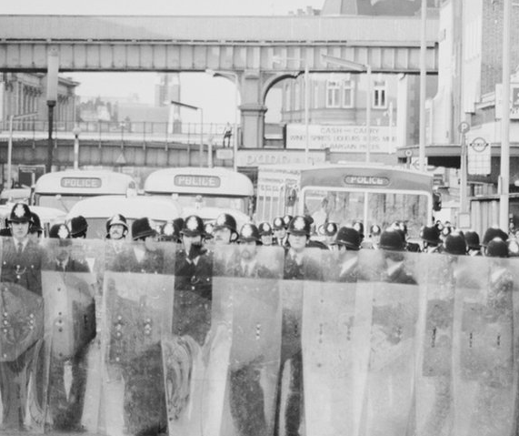
The History of Independent Custody Visiting and Equality
CIVIL DISORDERS 1981
In 1981 several outbreaks of unrest occurred in major cities – Bristol, Liverpool, Manchester, the West Midlands and London.
The most significant of these disorders took place in Brixton between the 10th and 12th of April when hundreds of young people attacked property and the police.
The cause of these disorders centered around people protesting about oppressive policing and in particular the alleged harassment of people, especially young black people, by the police – in short, these incidents were anti-police and voiced a lack of trust in the law and order authorities.
After days of unrest, these serious incidents led to the government ordering an urgent inquiry and appointing Lord Scarman to conduct a comprehensive investigation into the events.
Notes:
Talk to slide – same info as from pre read induction manual but useful to reiterate that the whole reason custody visiting came into effect was as an equalities response and the history behind this.
You can find further background reading on the Brixton riots here:
http://news.bbc.co.uk/1/hi/uk/4854556.stm
There is a Radio Four programme on the Brixton Riots here, which your ICVs may wish to listen to:
http://www.bbc.co.uk/programmes/b00zl4dq

Slide 4
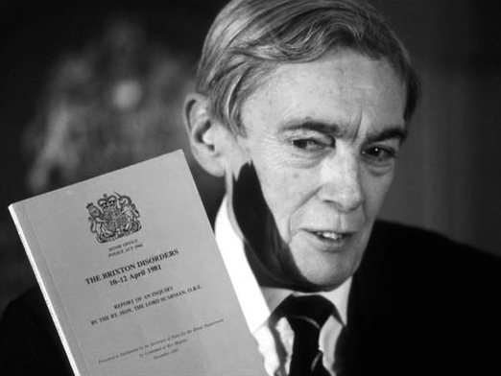
The History of Independent Custody Visiting and Equality
The resulting investigation – the Scarman Report – included several recommendations about reforming the law, community relations and policing practices to help tackle the central problems which caused the civil disorders.
The report advocated a system for members of the public from local communities to inspect the way the police detained people in their custody.
Originally referred to as lay visiting, independent custody visiting is the system that has been developed to meet this recommendation.
Notes:
Talk to slide – same info as from pre read induction manual but useful to reiterate that the whole reason custody visiting came into effect was as an equalities response and the history behind this.
Developed, statutory since 2002, PCCs took it on in 2012. One of very few statutory obligations.
You can find more background reading on the Scarman report here: http://news.bbc.co.uk/1/hi/programmes/bbc_parliament/3631579.stm

Slide 5
Exercise
What is equality?
How does ‘equality and bias’ impact on your work as an ICV?
What are the challenges around equality and bias when custody visiting?
Notes:
This is an discussion exercise (to be completed in smaller groups or as a round table discussion) so that you can gauge understanding of equalities, and how it impacts on their role. Useful here to begin to draw out that equalities doesn't’t mean everyone should be treated the same.
Definition of equalities is: Equality is about ensuring that every individual has an equal opportunity to make the most of their lives and talents, and believing that no one should have poorer life chances because of where, what or whom they were born, what they believe, or whether they have a disability. Equality work recognises that historically, certain groups of people with particular characteristics e.g. race, disability, sex and sexuality, have experienced discrimination.
Ask ICVs to discuss this either as a single group or in smaller groups, ask for feedback and discuss. The discussions should emphasise the importance of promoting equality and recognising and removing bias when visiting.

Slide 6
The Equality Act 2010
The Equality Act 2010 prohibits all employers, service providers and providers of education, from discriminating against, harassing or victimising individuals with protected characteristics.
Unlawful discrimination includes failing to provide accessible facilities for people with disabilities, or treating people unfavourably because of their race.
Notes:
This slide is to give the over arching principle and law on equalities.
You can find more background reading on the Act here: https://www.gov.uk/guidance/equality-act-2010-guidance
Could ask which part applies to ICVs – custody staff are service providers to detainee’s essentially and therefore covered under this part of the Act.
*NB – this slide / Act applies to Scotland, England and Wales only*

Slide 7
The Equality Act 2010 – a positive duty
All public bodies have to consider all individuals when carrying out day-to-day work, shaping policy, delivering services & in relation to their own employees.
Also requires public bodies to have due regard to the need to:
Eliminate discrimination,
Advance equality of opportunity, and
Foster good relations between different people when carrying out their activities.
Notes:
Read to slide – this slide talks about the positive duty.
Please note that this is something that all public bodies or services (so including custody visiting) should be doing all of the time. It is a proactive duty, ICVs should complete this duty whilst carrying out their role.

Slide 8
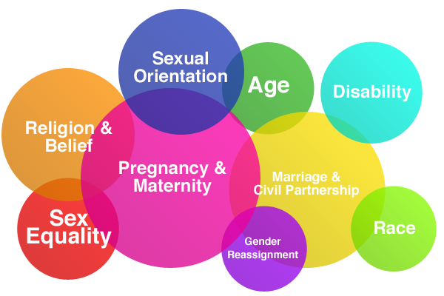
What are the protected characteristics?
Notes:
This slide introduces the characteristics, it may be that ICVs comment on the fact that a great deal of people will fall under one or more of these characteristics. If this doesn’t come up in discussion then ask the question of how many people they see in custody will fall under one or more category?
What does this mean? It means that an individualised approach is required with due regard to the protected characteristics by everyone who comes into contact with the person. i.e. custody should treat each person as an individual and seek to meet their needs.

Slide 9
Exercise – how might each group be affected by the custody environment?
Age
Disability
Gender reassignment
Marriage and civil partnership
Pregnancy and maternity
Race
Religion or belief
Sex
Sexual orientation
Notes:
Depending on group size, either ask ICVs to discuss in smaller groups or as a whole group discussion, how custody could impact differently on the protected characteristics.
Essentially want to ensure that they think through accessibility and vulnerability of various groups, next slide will have examples for each on it, so just an open discussion at this point.

Slide 10
What should ICVs look for in terms of equalities? Some examples
Age
Physical health needs, such as walking aids, able to get up and down from beds. If detainee is a child, is custody risk assessing & treating child as priority / vulnerable?
Disability
Is the detainee able to use the facilities? Have reasonable adjustments been made where possible? If a mental health or learning difficulty, has an AA been requested?
Gender reassignment
Has the detainee been referred to as the gender they refer to themselves as? If searched, was the search completed by someone of the same gender as they self identify?
Notes:
This slide contains examples of equality issues that ICVs may be aware of during their visits to custody.
Prompt the group for any further examples of what ICVs should check for

Slide 11
What should ICVs look for in terms of equalities – some examples – continued
Pregnancy and maternity –
If a breastfeeding mother, has a breast pump been provided for expressing? Are any dependent children being looked after outside of custody?
Religion or belief -
Has the detainee been given any religious items they might need? Are they stored correctly?
Sex –
If female, has the detainee been offered sanitary protection, was this of the appropriate type they needed?
Notes:
As before, ask for additional things ICVs should look for and prompt for any more examples in their work

Slide 12
General equalities ethos for ICVs
People in police custody are vulnerable as they are reliant on others for their care and some basic needs.
Detainees have the right to be treated fairly and with respect regardless of their backgrounds and life experiences.
If something feels wrong – report it.
If work should be praised – report it.
Notes:
This is a reminder / revisit to stress that ICVs are in custody as members of the public. They do not need to become too embroiled in equalitt legislation and protected characteristics, but should report anything that feels wrong to them and to praise any good work or efforts they see.

Slide 13
Quiz
What report was written after the Brixton riots?
What did the report recommend?
Give a definition of equalities
Name 4 of the protected characteristics
Notes:
A quiz for your ICVs to assist learning.

Slide 14
Quiz - Answers
What report was written after the Brixton riots?
The Scarman Report
2. What did the report recommend?
A system for members of the public from local communities to inspect the way the police detained people in their custody
3. Give a definition of equality
Equality is about ensuring that every individual has an equal opportunity to make the most of their lives and talents, and believing that no one should have poorer life chances because of where, what or whom they were born, what they believe, or whether they have a disability. Equality work recognises that historically, certain groups of people with particular characteristics e.g. race, disability, sex and sexuality, have experienced discrimination.
4. Name 4 of the protected characteristics
Age, Disability, Gender reassignment, Marriage and civil partnership, Pregnancy and maternity, Race, Religion or belief, Sex and Sexual orientation

Slide 15
What is Unconscious Bias?
We all have biases - becoming aware will help to mitigate them.
This term is used to describe bias or prejudice that we are not aware of.
Research shows that our brains jump to assumptions and conclusions without us even knowing it.
Personal attitudes and beliefs are shaped by the way we have been brought up and how we perceive other people.
Notes:
This section is to make ICVs aware of bias, what it is and how to think about the biases they might have, bias is a sensitive area for most people as its sometime uncomfortable to admit we have them, and facilitators should be careful that there is no discomfort or conversations about personal biases during this part of the session, it’s a general discussion to provoke introspective thought.

Slide 16
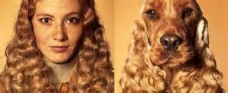
Two types of Unconscious Bias
Affinity bias
We show a preference for those who appear similar to ourselves and our families.
Confirmation bias
We find what we’re looking for - the tendency to search for, favour, and recall information that confirms one's previously held beliefs. The effect is stronger for emotionally charged issues and for deeply entrenched beliefs.
Notes:
The picture is of a dog and its owner, light point to make on affinity bias that people prefer those who look similar to themselves. Confirmation bias, could choose an example of estate agent or banker or another role perceived as unpopular, discuss if there is a negative perception of someone's job then you might look for behaviours that reiterate your thoughts. Try to keep these examples nice and light but make the point that this can apply to all areas of bias and the protected characteristics.

Slide 17
Exercise
A young boy is being driven by his father when the car crashed. They were both taken to hospital and the surgeon on call said “I can’t deal with this person, he’s my son”
How would you explain this?
Notes:
Ask in pairs to discuss the question. You only need to give a couple of minutes for this. Usually not everyone will get it and you get answers of step-dad, blended families etc. Typically there will be at least one pair or individual who will come up with answers as to why the surgeon is male. The answer is of course that the surgeon is the boys mother. Discuss gender and roles, police – man, doctor – man, nurse – woman, firefighter – man, secretary – woman. You might want to do a quick-fire shout out the answers and read a list of roles.

Slide 18
The Halo & Horns Effect
The “halo effect” is the concept by which a person who is judged positively on one aspect is automatically judged positively on several other aspects without much evidence.
The “horns effect” is the concept by which a person who is judged negatively on one aspect is automatically judged negatively on several other aspects without much evidence.
We tend to pay less attention to a person’s negative traits after discerning one or two positive traits in the first few minutes of meeting them.
Notes:
Talk to slide.

Slide 19
Unconscious Bias - Triggers & Solutions
Bias Trigger | Solution
Denial | Self-knowledge, be aware of your biases and do not suppress them.
Worry | Relax – when you stress about your biases they are more likely to slip out or cause you to avoid people.
Rushing | Take time to make decisions about people – biases are most active when we are rushing, stressed, tired, frustrated or angry.
Subjectivity | Follow fair policies & procedures with safeguards to prevent bias, challenge yourself to check evidence for & against decisions, acknowledge that your conditioning is imbalanced, seek diverse perspectives e.g. on a decision making panel or from your ICV partner.
Media Influence | Seek stereotype-defying examples, broaden your positive/alternative media and culture input to balance out the negative
Lack of experience or connections | Learn about cultures, communities and identities from your own via networking, training, books, documentaries, films, community events and festivals, visits to local support groups, shadowing, travelling and listening to the experiences of others.
Notes:
Run through tips with ICVs

Slide 20
Objectives – a recap
To explore the history of custody visiting and reiterate the importance of equality.
To examine what ‘equalities’ means in the context of custody visiting
To examine what unconscious bias is, how it can affect our work and how to mitigate against it.
Notes:
Use this to check that your ICVs have met the objectives as part of their training.

Slide 21
Any questions?
Notes:
Final slide to take questions

